Slide 1
Post processing

Slide 2
Support structure
Support structures are often hollow, which means you are not continuously machining metal as you cut through them.
A thin-walled, mostly solid support, gap, then another thin wall, and so on. Furthermore, most supports are not fully dense, particularly in the build direction.
Since the supports will be removed from the finished part, it seems unnecessary to make them fully dense, so laser-path planning algorithms often skip every other layer of the supports, saving material and reducing build time.

Slide 3
Support structure
Overall, the purposes of support structures can be categorized into three types:
Some printing processes may include high thermal gradients, especially metal processes. Therefore, shape distortions and residual stresses may occur due to this excessive heat accumulation . In this case, the support structures play the role of both a heat diffuser and rigidity enhancer
Local deposition processes (such as fused deposition modeling (FDM), Direct metal deposition (DMD)) can only deposit material on existing surfaces below. A support structure is, therefore, necessary to ensure that material is deposited at the intended height and the expected output geometry is achieved.
Shapes of the printed parts may move or deform during the printing process, typically when fabricating unbalanced parts or the raw material (powder, resin) is unable to sustain the weight of that part. In this case, the support structure plays the role of a fixture. Here in this figure, if there is no support structure, the part is unable to stand in balance and will collapse. Further, a support structure can act as a tether in powder bed processes to stop any shift, especially layer shift during re-coating processes.

Slide 4
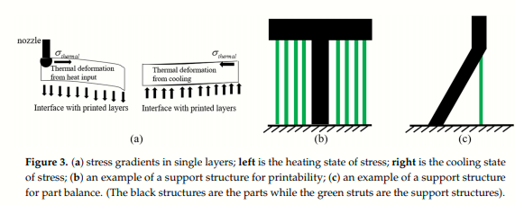
Support structure

Slide 5
Support structure removal
SLA
Needle nose pliers are typically used for support material that can be broken away, rather than cut away. ...
Putty-type knives, scraper knives, or pallet knives with sharpened edges are sometimes used for removing support as well.

Slide 6
Remove support material
Two types of support material:
PVA support
Breakaway support
Disolve PVA support
PVA can be used as a water soluble support for dual extrusion prints. The support structures can be removed by simply dissolving the PVA in water. The process takes several hours and leaves no trace afterwards.
1. Submerge the print in water
By putting a print with PVA in water the PVA will slowly dissolve. This process can be sped up by using:
Warm water. Warm water will decrease the dissolving time. When using PLA for the build material, ensure that the water is no hotter than 35 °C, otherwise the PLA part may deform. Never use water above 50 °C, as this increases risk of burning.
Stirring. Use stirring/running water to decrease the dissolving time. Moving water enables the PVA to dissolve more quickly (in some cases under three hours, depending on the amount of support material used).
Pliers. You can also speed up PVA dissolution by placing the print in water for approximately 10 minutes, then removing most of the support with pliers. When the print is placed back in the water, only the remaining parts of PVA will need to be dissolved.

Slide 7
Remove support material
2. Rinse with water
After PVA supports are totally dissolved, rinse the print with water to remove any excess PVA.
3. Let the print dry
Let the print dry completely and apply additional post-processing to the build material if desired.
4. Disposal of waste water
PVA is a biodegradable material, and in most cases disposing the water afterwards is easy. However, it is recommended that you check local regulations for more comprehensive guidance. The water can be disposed of down the drain, providing the waste water distribution network is connected to a wastewater treatment plant. After disposal, run hot water from the tap for approximately 30 seconds to remove any excess saturated PVA water and to avoid longer-term clogging issues.
It is possible to use the water for more than one print, however, this might extend the dissolving time. Through repeated use, the water becomes saturated by previously dissolved PVA, so for the quickest result, fresh water is recommended.

Slide 8
Remove support material
Remove Breakaway support
Prints using support material will require post-processing to remove the support structures. This can be achieved by breaking the support structures from the build material.
1. Tear the inner support structure
Start by removing the walls of the support structure with a gripping plier. This allows you to quickly tear away the majority of the inner support structure.
2. Pull the Breakaway support from the build material
After removing most of the support structure, the remaining part(s) can be pulled from the build material. Use cutting pliers to grip the Breakaway support in a corner and try to carefully get underneath it, then bend it upwards. Repeat this for several corners, so that you can loosen the support from the model around the corners. After this, pull the Breakaway support from the model.
3. Peel the last traces from the model
Sometimes a final layer of the support material remains after pulling the Breakaway support from the build material. If this happens, use cutting pliers to peel it off from a loose edge. Any leftover traces on the model can be removed with tweezers.

Slide 9
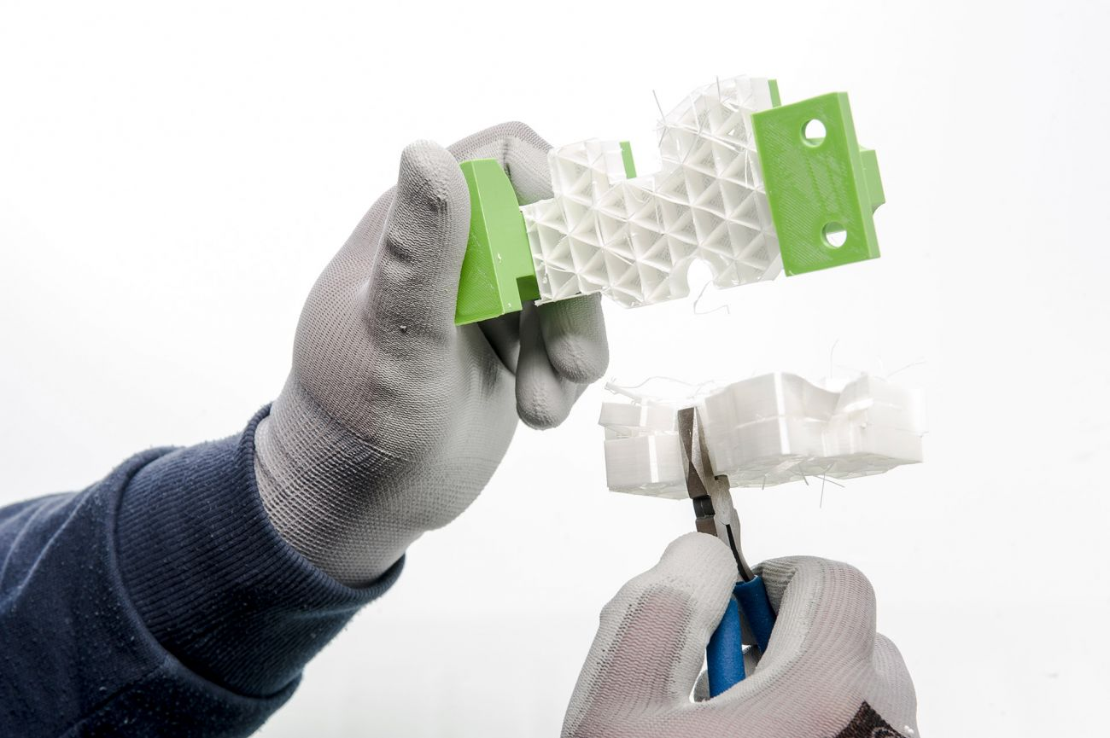
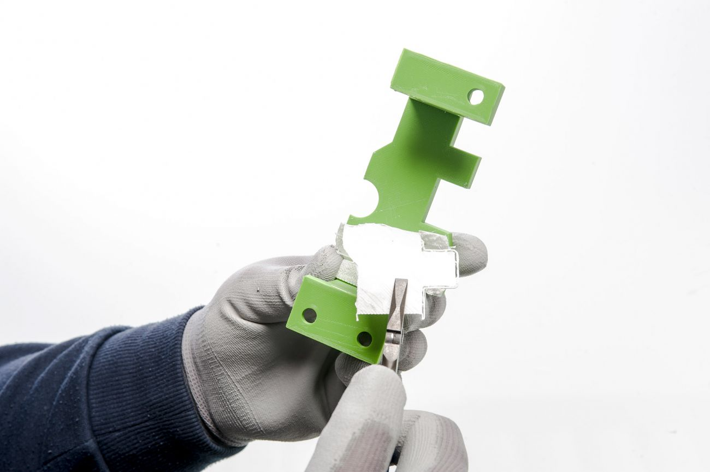

Slide 10
Easy Ways to Remove Metal Support Structures
1. Angle your supports
For areas where supports are needed inside the part (such as horizontal holes along the X or Y axis), part-to-part support contact will occur. That usually means a surface twice as big to post-process, which is not always desirable.
It is not always necessary for support structures to touch the part twice.
Using angled support structures, you can also connect the lower part of the support structure to the build platform to limit the affected surface quality. If you can’t avoid touching the part twice, you can guide the support to an area that can be post-processed more easily.
2. Use fine tooth structure
To ensure that your support structures are strong enough, but also easy to remove, combine strong supports with fine teeth. If you need a strong connection, we recommend that you let the teeth slightly penetrate the part, otherwise it might break off and cause a layer shift.
When not removed carefully, teeth can cause pits that damage the part, especially for sensitive features such as thin walls or lightweight structures. Therefore, another option is to go for predefined break-off points, which are shaped like an hour glass. These break off in the middle. You can then smoothen the surface to remove the rest.

Slide 11
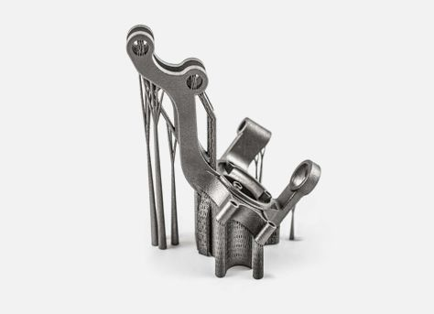
5 Easy Ways to Remove Metal Support Structures
3. Rescale the support structures
Support structure width doesn’t always need to be equally broad on the build platform as it is on the part. If no strong platform connection is required, you can scale it down to reduce the area that will need post-processing.

Slide 12
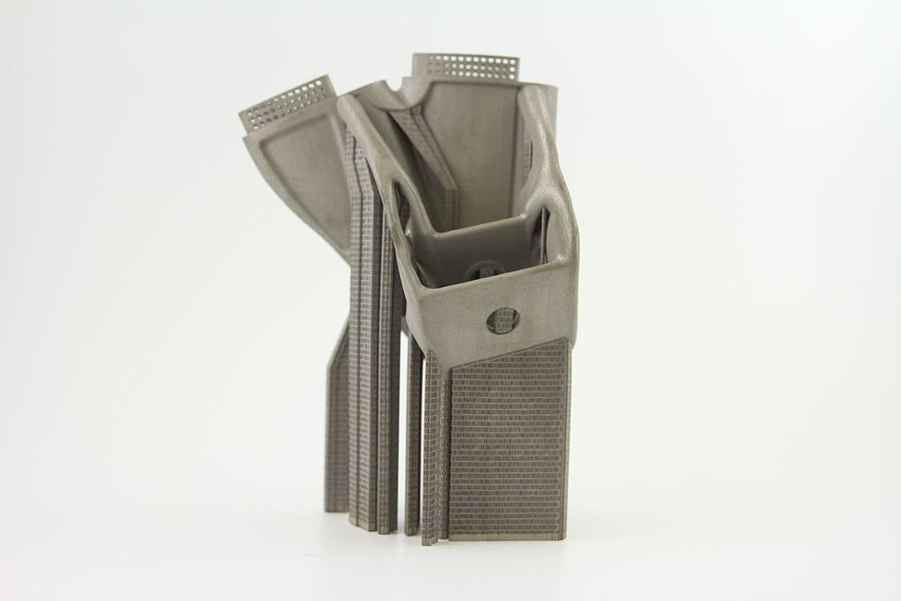
5 Easy Ways to Remove Metal Support Structures
4. Fragment block supports
Volumetric support is completely solid, block support is composed of a grid of lines, with each line normally assuming the thickness of the melt pool. Fragmented block supports or a clearance between support structures facilitates support removal.

Slide 13
5 Easy Ways to Remove Metal Support Structures
5. Milling off additional material
Finally, in certain cases, you can add additional material to the places that need support structures and mill it off to achieve the intended shape. This way the quality of the part is maintained, and no additional post-processing steps are needed as the supported areas are milled/polished anyway.

Slide 14
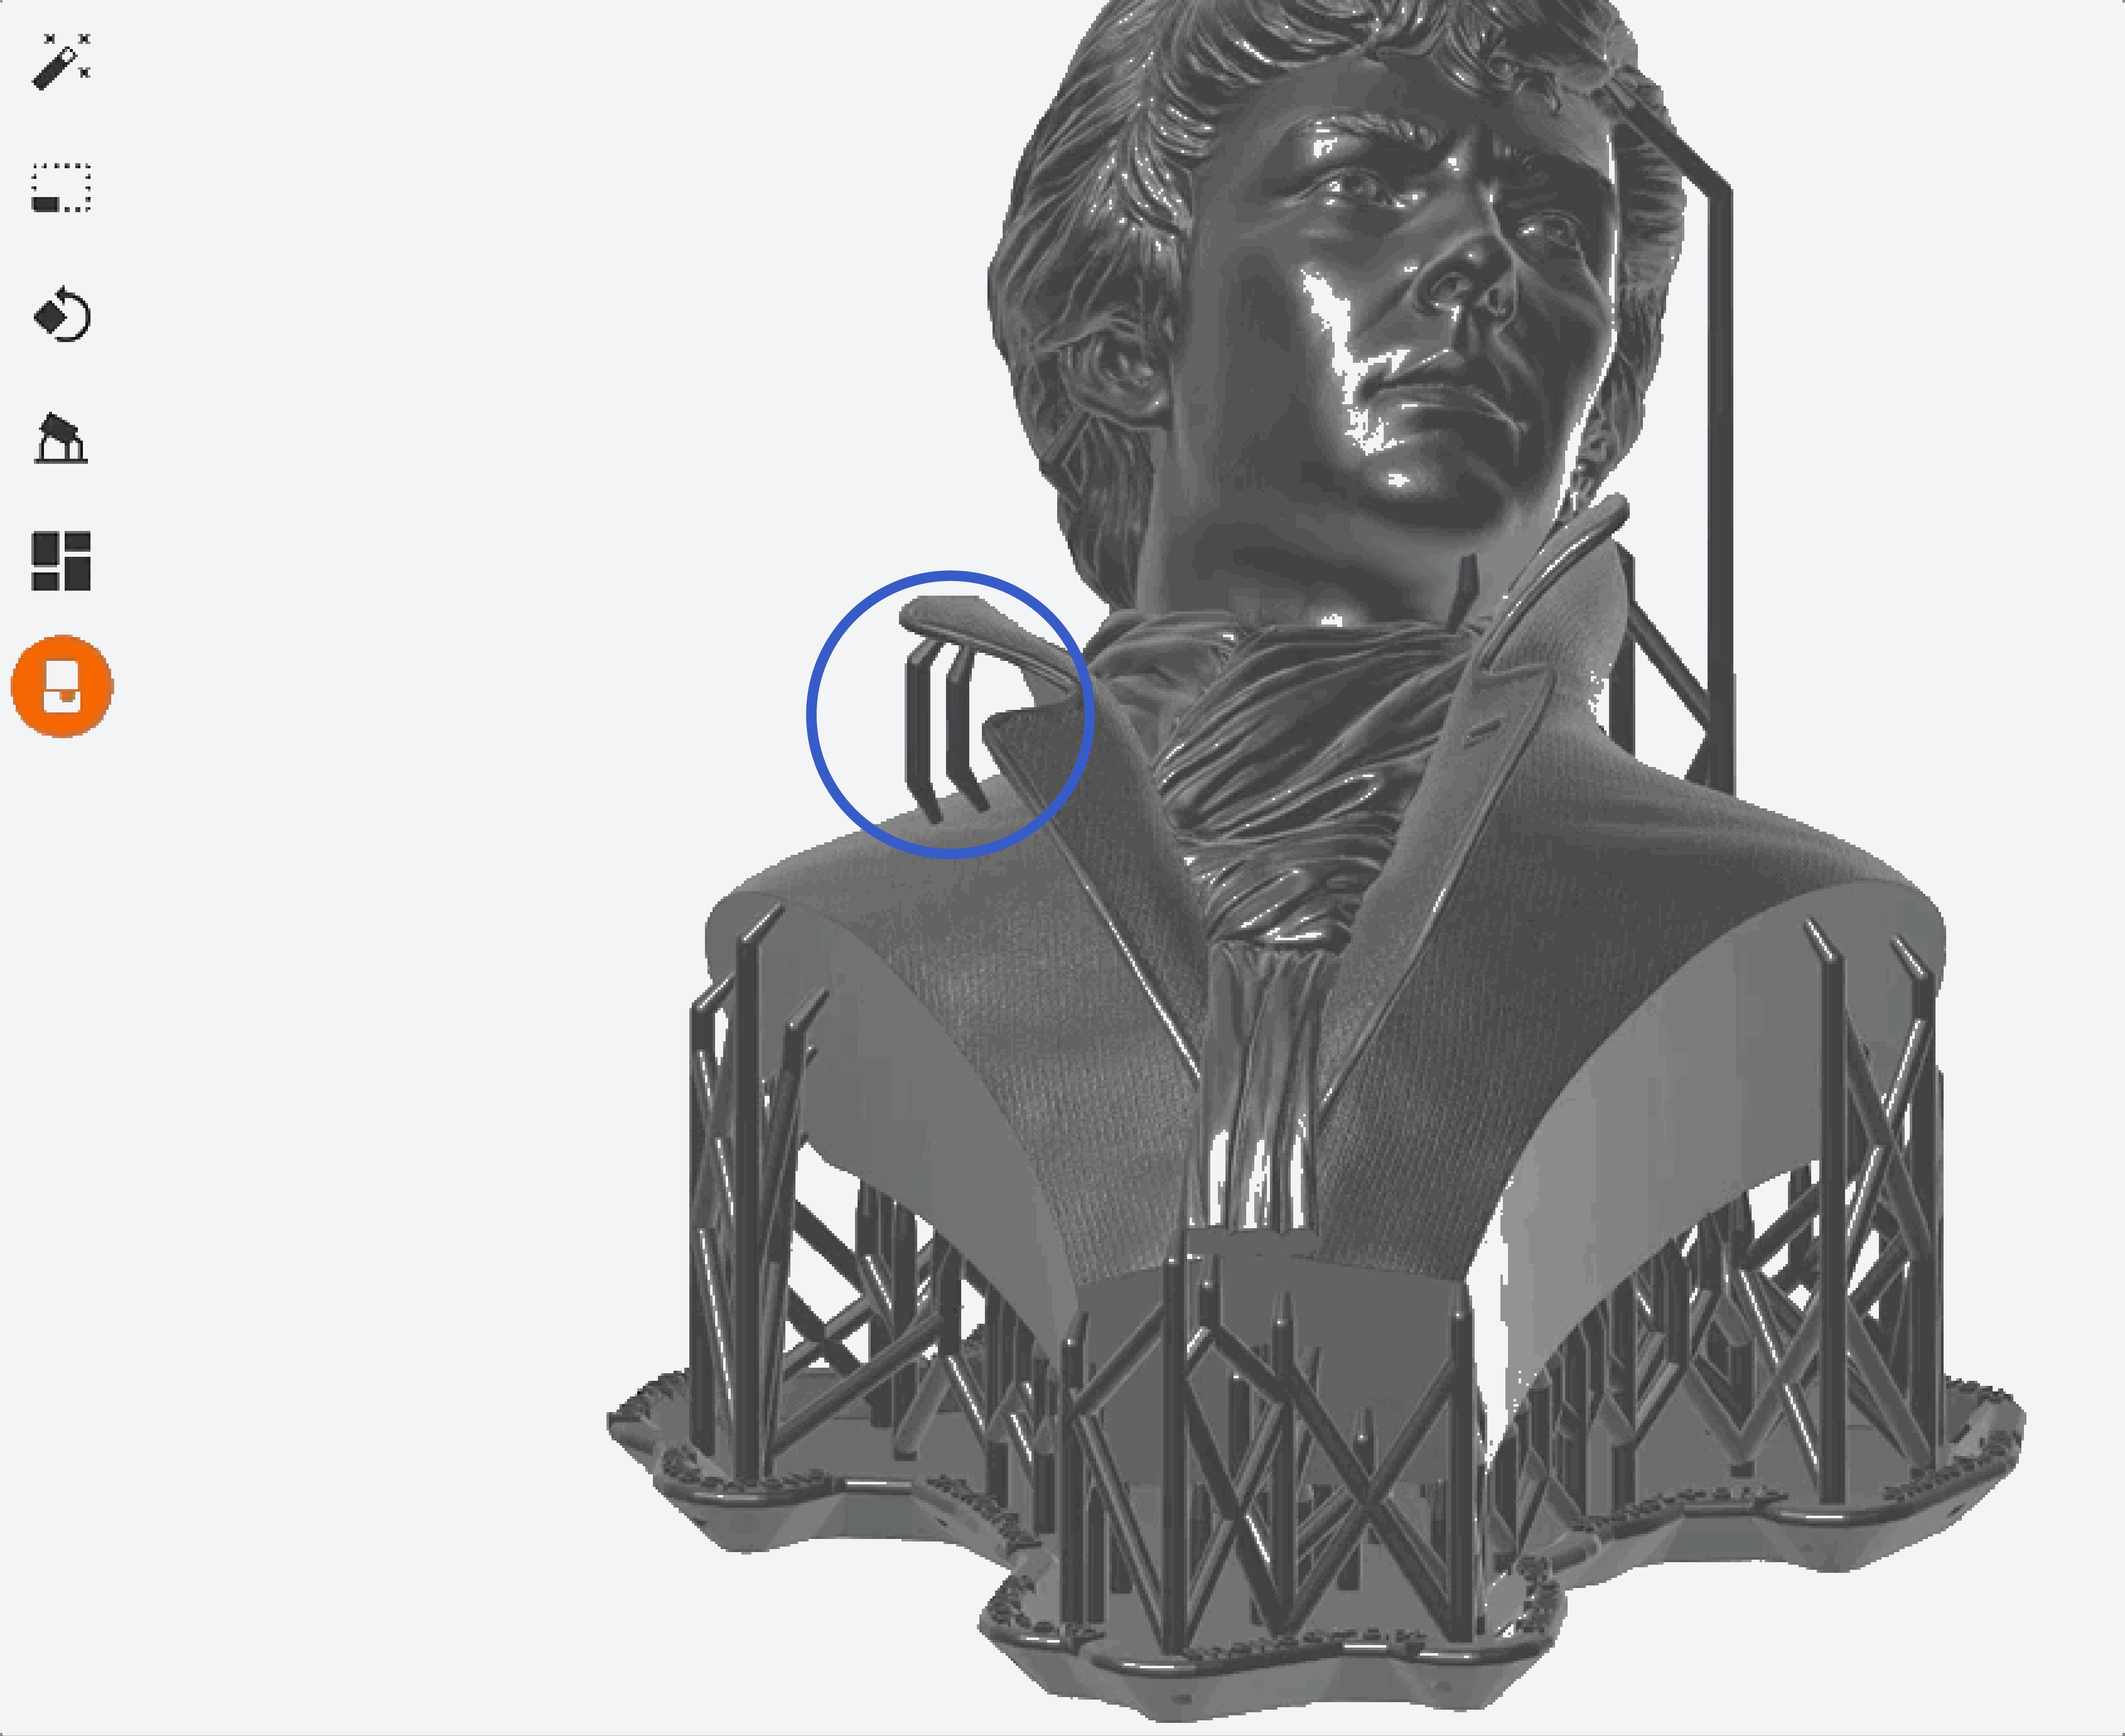

Slide 15
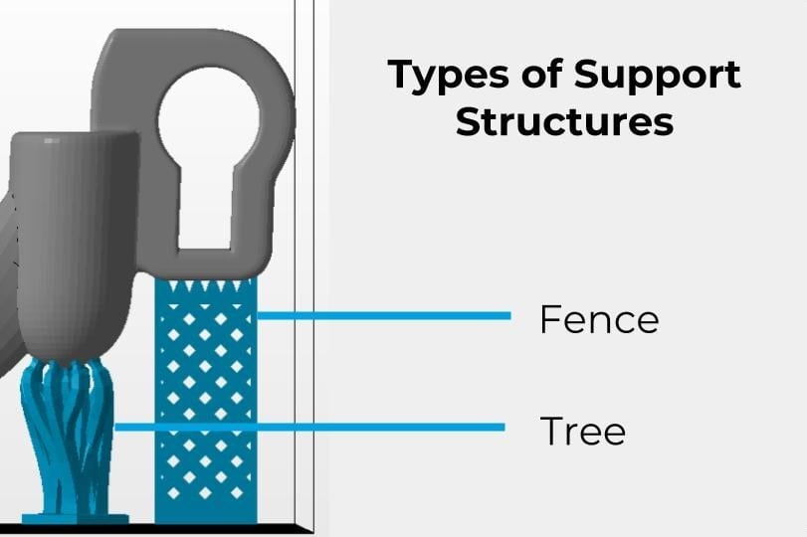
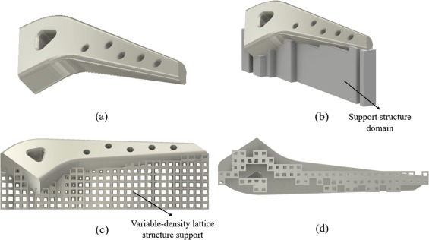
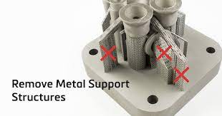

Slide 16
Support structure removal
The system removes support material by immersing parts in a bath of water, orange oil, or a mildly alkaline solution. It really depends on your choice of the soluble support material.
The system heats and circulates solution around the parts in the cleaning tank. The solution dissolves the support material without harming the underlying model material.
Notes:
3D printed parts may feel much the same way if your solvent temperature is too high. Every plastic has its own heat resistance. Some exotic thermoplastic materials like PEEK can withstand temperatures beyond 300 degrees C. But most common plastic materials settle in the range around 100 degrees C.
ABS will deform if you heat it beyond 90 degrees C. PETG withstands only up to 60 degrees C.
3D prints from PETG on speeding up the dissolution time and came too close to the deforming point in my solvent tank. Although higher temperature typically increases the dissolution process

Slide 17
surface texture improvement
One of the drawbacks of additive manufacturing or 3D printing is the quality of the surface finish. Building parts layer by layer will naturally result in visible layering or ‘stair stepping’ as it is often known.
Three options to improve the surface finish of your AM components:

Slide 18
surface texture improvement
Improving the surface finish of your AM part
Layering is a result of three variables: the curvature of the parts geometry, the orientation of the part with respect to the build chamber, and the layer thickness.
Out of those three, changing the parts geometry so it can be built by AM is the least likely option. There are however plenty of possibilities with respect to the other two.
1 Parts with flat surfaces
Parts with flat surfaces will generally build free of layering if they are orientated parallel or normal to one or more of the build chambers’ Cartesian planes.
If the part is curved in only one plane (such as a hollow extrusion profile or aerofoil) then it is best built with the curved profile lying in the XY plane, normal to the z-axis. In this way each layer is a constant profile and there is no transition across the chamber in the x and y directions. More importantly there is no stair stepping through the wall thickness.

Slide 19
surface texture improvement
2) Parts with doubly curved surfaces
Parts with doubly curved surfaces are the most challenging and there is no simple way to make the visible layering disappear. Some consideration of build orientation can assist, but there are always going to be areas of the geometry where the surfaces flatten out and large sideways steps between each layer are inevitable. Surface finish in these areas will therefore be compromised.
3) Layer thickness
If part orientation cannot help, then reducing layer thickness is arguably one of the best ways to improve surface finish. If you can put four layers into the space where you once only had one, then the results will be noticeably improved.
Modern AM machines are a lot more sophisticated than the previous version and many can be specifically calibrated to build at layer thickness measured in microns instead of millimetres. Building parts in 16 or 25 micron layers (that’s 0.016mm and 0.025mm) is now possible. If surface finish straight off the machine is important to you then these options are really worth considering.

Slide 20
surface texture improvement
Post operation options
As an alternative, you could consider post operations such as dressing the part by hand, sand blasting and machining. These are the ultimate way to get a top quality finish, but the processes require skill and are labour intensive and therefore expensive.
Post operation options also depend on the part’s material - plastics are easier to finish than metals. That is why it is recommended getting the best ‘off the machine’ finish.
If your AM parts are to be painted or chrome plated, then there is really no alternative to these post operations at present.

Slide 21
Accuracy In Additive Manufacturing
Additive Manufacturing (AM) processes generate plastic or metal parts layer‐by‐layer without using formative tools
process specific challenges such as a high surface roughness, the stair‐stepping effect or geometrical deviations inhibit the industrial establishment
Many process parameters and geometrical factors influence the manufacturing accuracy in AM which can lead to large deviations
geometrical accuracy constitutes an important quality characteristic and a great challenge for the further determination and improvement of AM
Geometrical deviations are unavoidable due to the physical manufacturing of parts and can generally be divided into four categories. The four categories are dimensional deviations (two‐point dimensions), form deviations (e.g. roundness , location deviations (e.g. perpendicularity) and surface deviations (e.g. surface roughness).

Slide 22
Accuracy In Additive Manufacturing
Suitable orientation of the part is crucial in AM for improving the Geometrical and Dimensional Tolerance (G&DT), reducing build times and minimizing support volume and part production costs. The part orientation affects surface accuracy, builds height, and supports volume.
The staircase effect has been recognized as one of the most important factors, affecting the part accuracy, and it is mainly caused by an inclined or freeform surface.
A prediction model was presented to study the shrinkage phenomena in photopolymerization during AM. In addition, it was found that when layer thickness increased from 0.2 to 2.0 mm, the staircase amount increased by 300%.

Slide 23
Accuracy In Additive Manufacturing
Influencing geometrical factors
The geometrical factors describe the shape and spatial position of parts within the AM build chamber . In the following, the geometrical factors and their variation steps are presented.
Nominal dimension (N):
A dimension is generally defined as the distance between two opposite points
The standard allows the cross‐process comparison of the geometrical accuracy between plastic and metal AM processes.
Dimension group:
The dimension group includes four different types of dimensions: external, internal, distance dimensions and dimensions of various steps, whereby the underlying paper focuses on external and internal geometries, for instance, the roundness of inner or outer cylinders.
Element geometry:
The element geometry is an important factor. Adam developed a classification of geometrical elements, where basic elements are divided into non‐curved (i.e. cuboids), simple‐curved (i.e. cylinders) and double‐curved elements (i.e. spheres)

Slide 24
Accuracy In Additive Manufacturing
Influencing geometrical factors
Orientation and alignment:
Due to the layer‐by‐layer manufacturing, the spatial alignment of parts shows a major influence on the geometrical accuracy .
In the studies on the examination of dimensional tolerances, the test specimens were aligned along the x‐, y‐ and z‐axes of the build chamber in order to investigate the influence of the shrinkage factors within AM processes.
For the investigation of form and location deviations, finer orientations (0°, 30°, 45°, 60° and 90°) are selected to investigate their influence on the occurring deviations in more detail.
Position in the AM build chamber:
AM machines use different heating systems and temperature controllers trying to generate a homogeneous temperature distribution during and after the manufacturing.
The machine environment generates different temperature areas and gradients within the machine, whereby geometrical deviations can occur. This fact was already represented in on different positions in the x‐y‐plane.
The results show that it is difficult to deduce a clear correlation between the chosen position and occurring deviations. However, an influence is obvious.

Slide 25
Machining
CNC machining is typically used to mill a part out of a block of material. But with complex, additive manufactured parts, machining can function as a secondary operation to achieve very specific dimensional tolerances that cannot be met with 3D printing alone. It’s also often used to add threads for inserts.

Slide 26
Aesthetics in AM
3D printing technology breaks the rules of conventional manufacturing. It allows engineers to build complex geometries, create massive parts, consolidate multiple part components and design solely for form, fit and function rather than for the manufacturing process.
Finishing/Post-processing enhances what a 3D printer can do, improving the aesthetics providing impeccable, near injection molded finishes, to meeting tight tolerances and achieving added durability and chemical resistance.

Slide 27
Aesthetics in AM
The primary finishing operations available for AM techniques are
Smoothing
Sanding
Plastic parts made with AM can be sanded by hand or with orbital sanders to remove the stair-stepping effect that is inherent to the process.
Finishing experts use a variety of grits to smooth the surface to the desired aesthetic.
Vapor Smoothing
Vapor smoothing addresses stair-stepping on the surface of parts built with FDM by slightly melting the outer surface with a solvent. A part is dipped into a vapor chamber for a few seconds, which causes the plastic to liquefy, then the part is immediately dipped in a cooling chamber to stop liquefaction. The result is a smoother, shinier part.
Media blasting, defined in the next section, may be used after vapor smoothing to deliver a matte finish that is often preferable for secondary filming, coating and plating operations.
Vapor smoothing also preserves dimensional integrity and can help eliminate the inherent porosity of FDM parts for liquid or gas-holding applications.

Slide 28
Aesthetics in AM
Coating
Sealing
FDM parts are naturally porous right off of the machine which presents an obstacle for containing gases and liquids.
The solution is sealing the part with a water or chemical resistant epoxy coating.
Vapor smoothing also seals part surfaces, but is limited to applications no higher than atmospheric pressure.
Epoxy brushed onto the surface of a part generates an airtight seal and is resistant to many chemical agents.
The other option is immersing FDM parts in epoxy resin and using a vacuum to infiltrate the epoxy to create a watertight seal and resistance to chemical agents and high temperatures.
Electroplating
Electroplating deposits a thin layer of metal, such as chromium, nickel, copper, silver or gold, on a part’s surface.
The electroplated coating gives the appearance of production metal and provides a hard, wear resistant surface with reflective properties.
Prior to plating, FDM parts need to be sanded smooth and sealed with either a vapor smoothing process, solvent dipping or paint to aid chemical adhesion.

Slide 29
Aesthetics in AM
Priming and Painting
FDM parts can be primed and painted to produce attractive conceptual models, functional prototypes and end-use parts.
Prior to painting, FDM parts should be polished with vapor smoothing, application of body filler and sanding.

Slide 30
Property Enhancements Using Non-Thermal Techniques
Powder-based and extrusion-based processes often generate porous structures. In certain cases, this porosity can be infiltrated by a higher strength substance such as cyanoacrylate (Super Glue). Proprietary methods and materials have also been developed to enhance the strength, ductility, heat deflection, flammability resistance, EMI shielding, or other properties of AM parts using infiltrants and different types of nano-composite reinforcements.
Curing is a common post-processing procedure for photopolymer materials. During processing, many photopolymers fail to achieve complete polymerization.
As a consequence, these parts are placed in a post-cure system, a tool that floods the part with UV and visible radiation in order to completely cure the surface and subsurface regions of the part.
In addition, the part can undergo a thermal treatment in a low-temperature oven, which can help to fully cure the photopolymer and, in some cases, significantly enhance the mechanical properties of the part.

Slide 31
Property Enhancements Using Thermal Techniques
After AM processing, several pieces are thermally processed to enhance their properties. In the case of DED and PBF techniques for metals, heat treatment is primarily intended to form the desired microstructures and/or to relieve residual stress.
Traditional heat treatment techniques developed for the specific metal alloy used are often used in these cases. In some cases, however, special heat treatment methodologies were implemented to maintain the fine-grained microstructure inside the AM component while also providing relief of stress and improvement of ductility.
Until the advent of DED and PBF techniques able to directly process metals and ceramics, many techniques for the production of green metal and ceramic parts using AM were developed. These were then post-processed in furnace to achieve dense, usable metal, and ceramic parts production.

